Slide 1

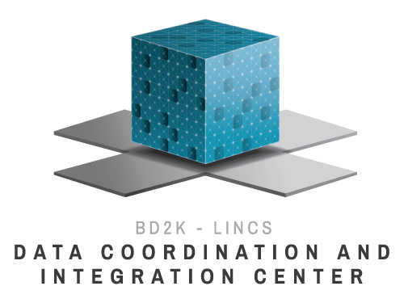
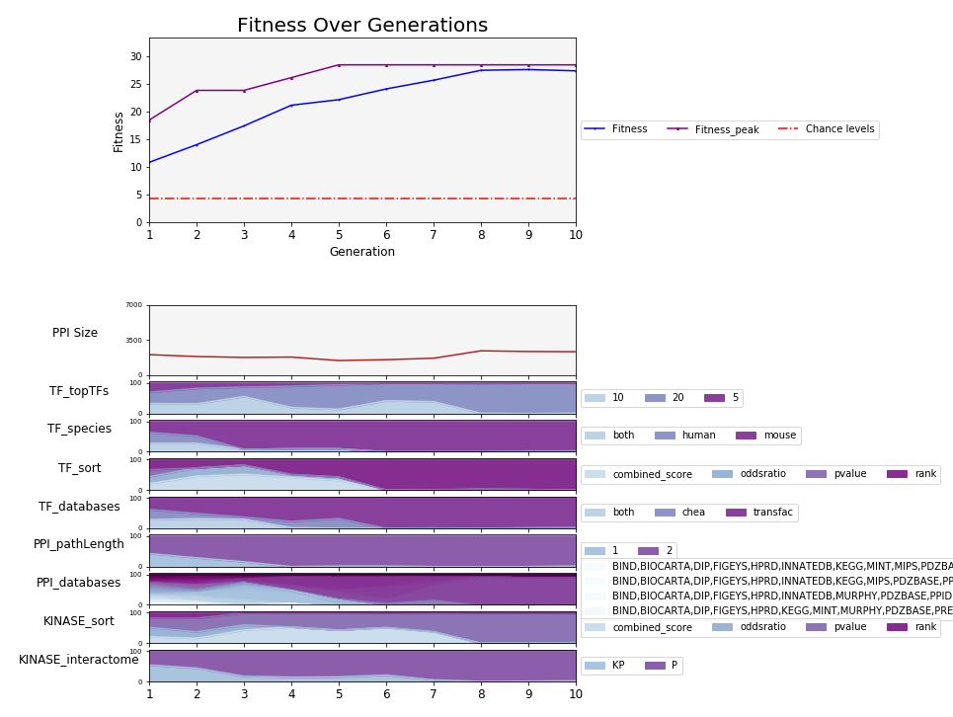
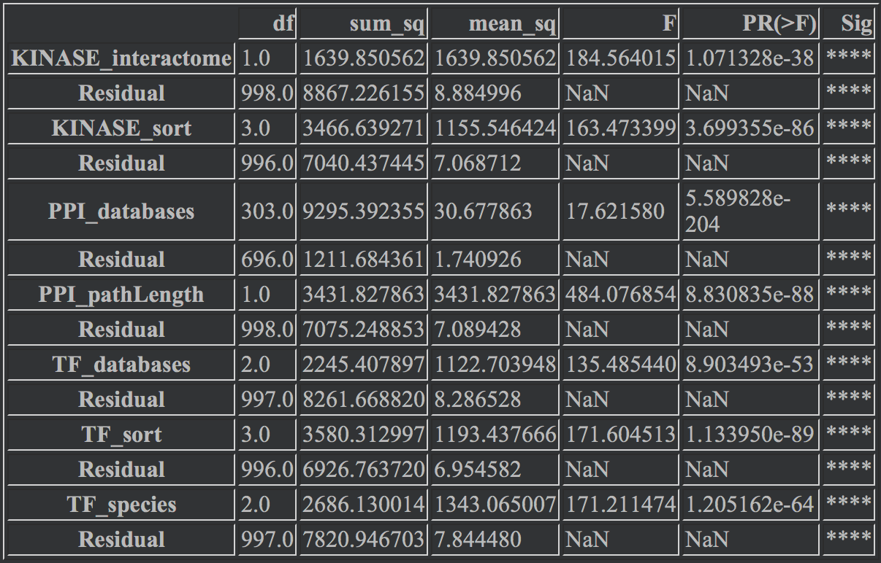
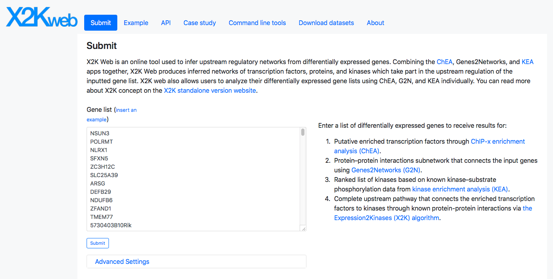
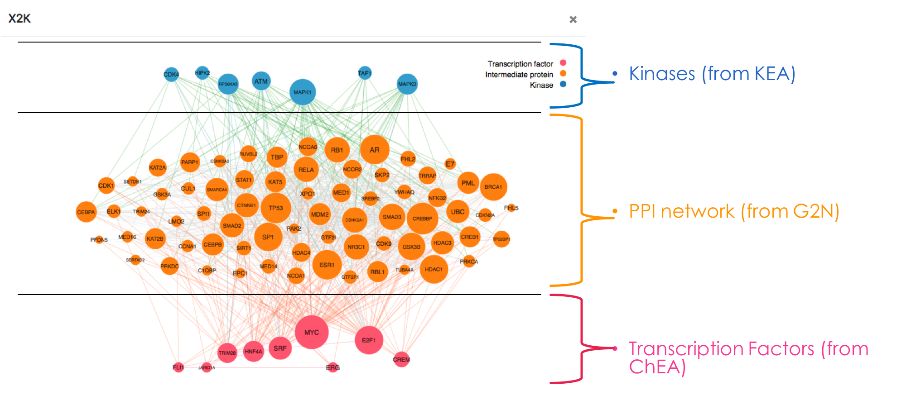
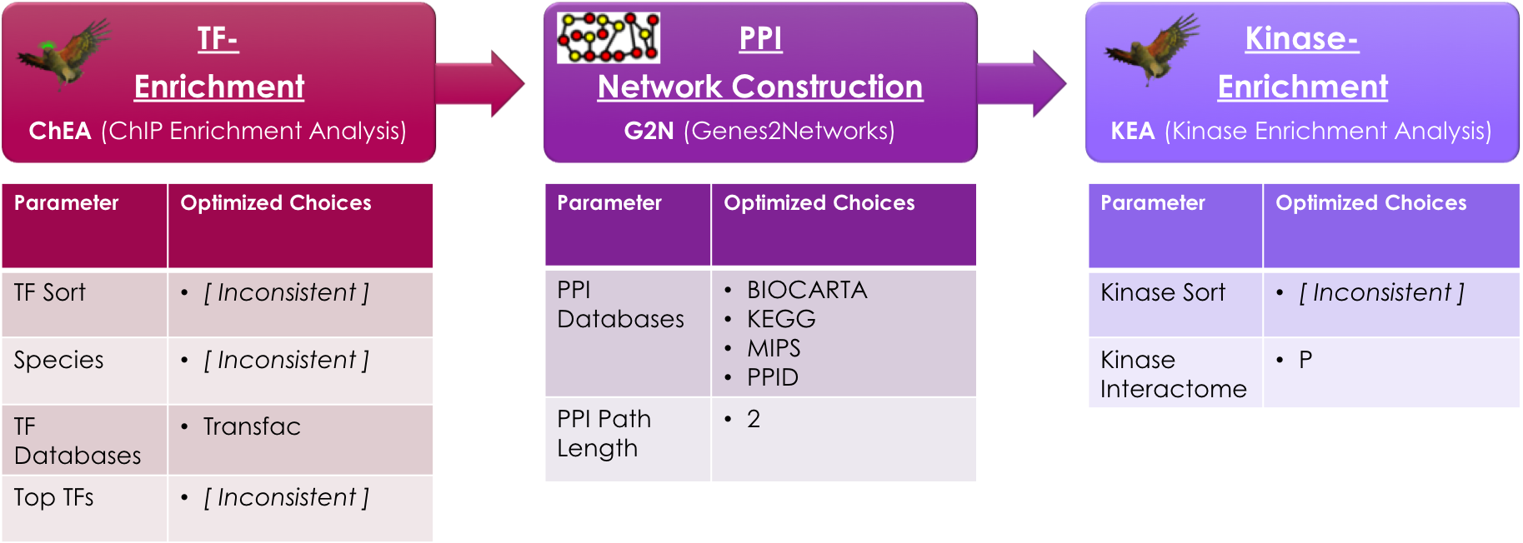
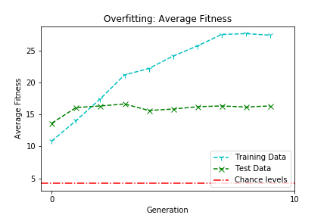
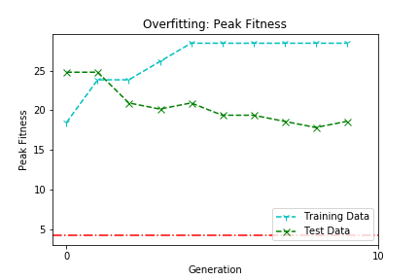
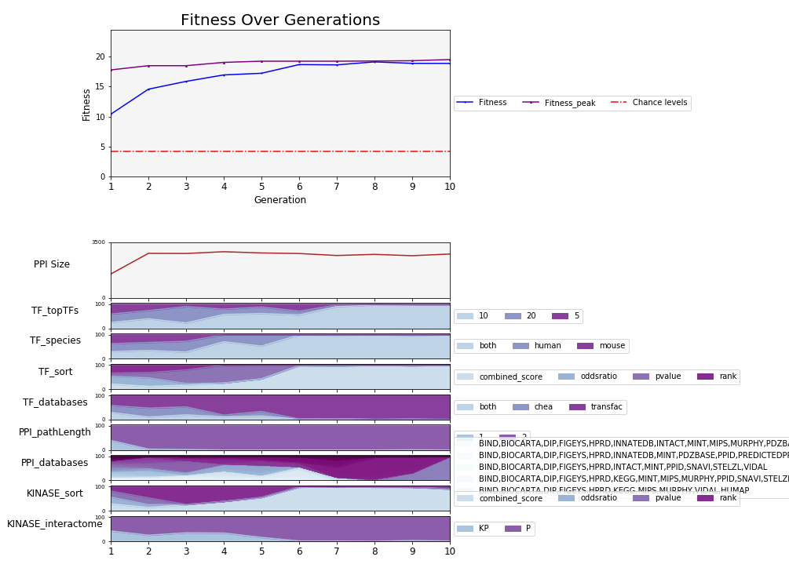
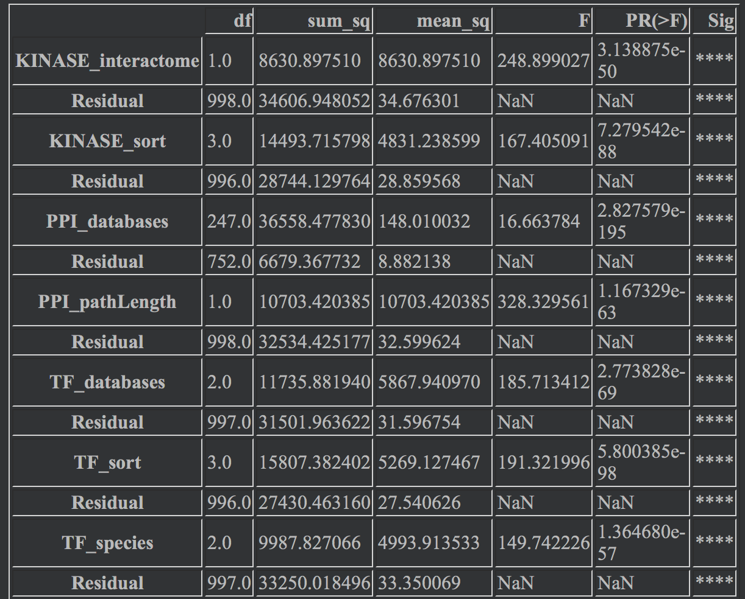
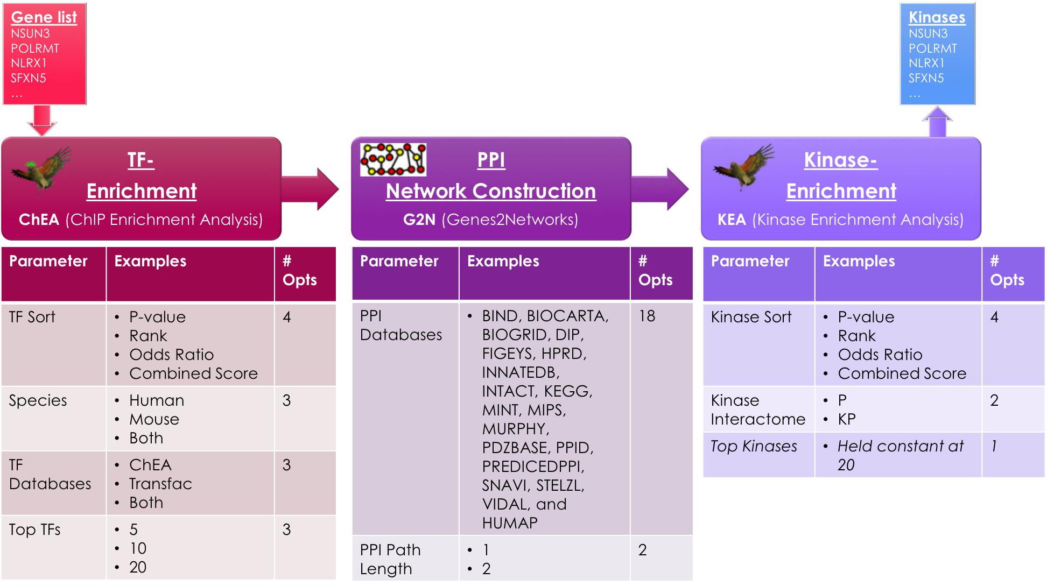
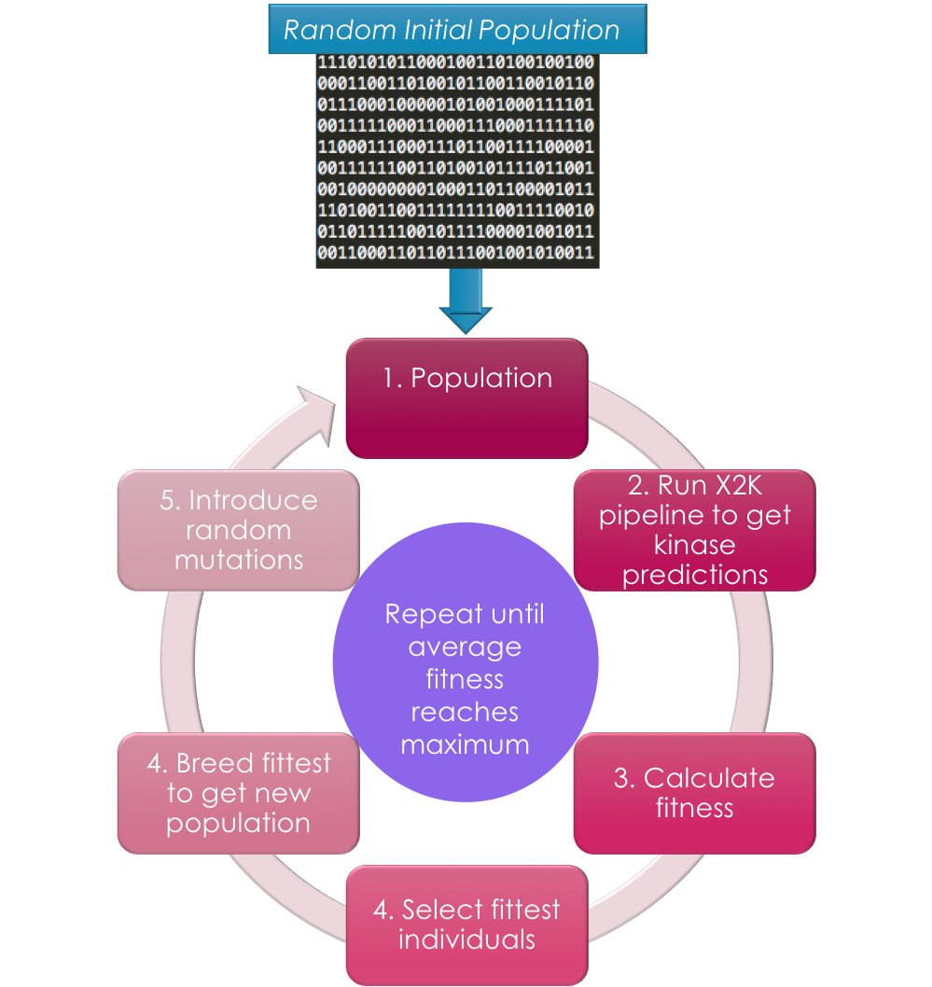
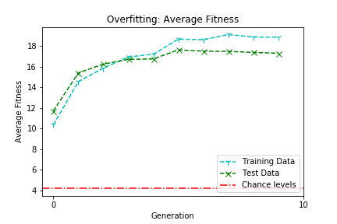
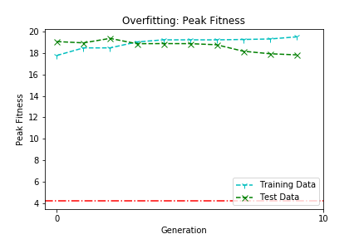
C
Learning X2K: Parameter Optimization Via Genetic Algorithms to Calibrate the Expression2Kinases Pipeline
Brian M. Schilder¹ , Alexander Lachmann¹, Maxim Kuleshov ¹, Avi Ma’ayan¹
¹Big Data to Knowledge (BD2K) Library of Network-based Cellular Signatures (LINCS) Data Coordination and Integration Center (DCIC),
Mount Sinai Center for Bioinformatics, Department of Pharmacological Sciences, Icahn School of Medicine at Mount Sinai, New York, NY
Introduction
Results
Discussion
While whole-transcriptome technologies can accurately measure the level of mRNA at a global scale, and at a relative low cost, directly measuring cell signaling network activity is both less accurate and more expensive. Hence, computational methods to infer cell signaling network activity from gene expression data are needed. Kinases are enzymes that can regulate downstream molecular pathways by phosphorylating other proteins. Due to their regulatory role, kinases are promising targets for a number of diseases. Expression2Kinases (X2K) is a computational pipeline that takes as input lists of differentially expressed genes, it then performs enrichment analysis to prioritize transcription factors that most likely regulate the observed changes in expression. Next, known protein-protein interactions are used to connect the identified transcription factors to form a subnetwork. Finally, kinases enrichment analysis is performed to prioritize protein kinases known to phosphorylate substrates within the subnetwork of transcription factors and intermediate proteins. The workflow can run with a variety of parameter settings and employs a variety of processed background datasets. In this project, we aimed to learn these parameters to optimize the pipeline for identifying the “correct” kinases using genetic algorithms, a machine learning method for parameter optimization.
[Run 1]: X2K GA Results Using GEO Kinase Perturbation Data for Benchmarking
Parameter optimization: GA Runs 1 and 2 differed in the optimal parameter combination that produced the peak fitness, including: Top TFs, TF Species, and TF Sort.
TF Rank: More sophisticated results-ordering methods (i.e. rank, combined score) outperformed simpler metrics such as raw p-values (though not Kinase Rank in Run 1).
TF Databases: Both GA Runs selected TRANSFAC as the optimal TF Database, suggesting this is preferable to ChEA even when combined with TRANSFAC.
PPI Databases: While not all PPI databases overlapped between Runs, BIOCARTA, KEGG, MIPS, and PPID were selected in both Runs suggesting this combination of databases provide more robust results in X2K.
Kinase Interactome: Both Runs selected P, suggesting Phosphorylation datasets perform better for recovering kinases, though it remains to be seen whether combined the two would perform even better.
Potential Confounds: It is possible that X2K is biased towards constructing large PPI networks. While, both Runs did indeed create large PPI networks (~2,300-2,700 proteins) this did not appear to be related to fitness in Run 1.
A
Users submit gene lists here
Table 1. Results of a series of one-way ANOVAs statistically testing the relationship between fitness and each parameter.
Main Results:
Stabilized after ~8 generations
Average fitness stabilized at ~26%
Peak fitness = ~28% of kinases recovered
Average PPI size = 2,353 proteins
All parameters had a significant impact on fitness (p<0.0001).
While there were similar patterns of increasing peak fitness over generations, the Training and Test data did differ significantly on this run (p<0.001).
Fig 1. The X2K Web landing page and an example of its output.
Methods & Materials
B
C
Fig 4. Parameter evolution over generations in GA optimization (A). Overfitting test results between training data and test data using average fitness across
the entire population (B) and peak fitness (C).
The X2K Pipeline
The X2K pipeline is comprised of these three components (Fig 2):
[1] ChIP Enrichment Analysis (ChEA): Ranks transcription factors (TF) based on TF targets that are enriched within the input gene list using ChIP-seq experiment-derived TF databases including the ChEA 2015 database, the combined TRANSFAC databases, or both.
[2] Genes2Networks (G2N): Generates protein-protein interactions (PPI) subnetworks given a list of enriched TFs. G2N draws from 18 non-mutually exclusive literature-curated and/or experimentally-derived PPI resources: BIND , BIOCARTA (www.biocarta.com), the Database of Interacting Proteins (DIP), Figeys, the Human Protein Reference Database (HPRD), InnateDB, IntAct, KEGG, the Molecular INTeraction Database (MINT), the Munich Information Center for Protein Sequences (MIPS), Murphy, PDZBASE, PPID, PREDICTEDPPI, SNAVI, Stelz et al., Rolland et al., and hu.MAP.
[3] Kinase Enrichment Analysis (KEA): Two different types of data are available through KEA: kinase-protein interactions (KP) and phosphorylation reactions (P). KP data is composed of data integrated from the kinase subsets of several PPI databases, including NetworkIN, Phospho.ELM, MINT, HPRD, PhosphoPoint and SwissProt. P data was manually curated from the literature.
Genetic Algorithms for Parameter Tuning the X2K Workflow
The GA operates by producing a population of random binary strings that map onto modifiable parameters in each step of X2K, runs the X2K pipeline each string's corresponding parameter combination to assess fitness, crosses over the fittest individuals to create a new population, introduces random mutations, and repeating until the population fitness stabilizes (Fig 3).
GA Settings:
Generations: 10; Population Size: 100/generation
Number of fittest individuals per generation bred (and then retained in next population): 10
Crossover points: 3; Random mutation rate: 0.01
Validation: To assess the ability of each X2K parameter combination to recover kinases, differentially expressed genes from kinase perturbation experiments were compiled from the Gene Expression Omnibus (GEO) (Run 1), or from the LINCS L1000 data using the Drug Repurposing Hub to identify kinase inhibitor drug targets (Run 2).
Fig 6. Consensus optimal parameter combinations as determined by the overlap of both GA runs.
[Run 2]: X2K GA Results Using LINCS L1000 Drug Perturbation Data + Drug Repurposing Hub
Conclusions
A
Using optimized parameters, X2K can recover the “correct” kinases with ~20-28% accuracy depending on the particular dataset. This is considerably greater than chance (4.22%).
Potentially greater rates of kinase recovery and consistency across validation datasets can be achieved by adding additional databases and parameters.
The pipeline optimization can be divided into two streams: including literature-biased resources, such as PPI and kinase-substrate interactions from extracted from low-content published studies, and high content only pipeline that includes only data from high throughput methods.
The optimized parameters will inform the X2K Web application and used to infer kinases for various projects.
Fitness scores of each parameter combination are defined as the % of experiments in which the known perturbed kinase was recovered. For the LINCS L1000 data, each experiment’s score was divided by the number of kinase targets a given drug was associated with to avoid inflating fitness due to multiple targets
Table 2. Results of a series of one-way ANOVAs statistically testing the relationship between fitness and each parameter.
Main Results:
Stabilized after ~6 generations
Average fitness stabilized at ~18%
Peak fitness = ~20% of kinases recovered
Average PPI size = 2,767 proteins
All parameters had a significant impact on fitness (p<0.0001).
While there were similar patterns of increasing fitness over generations, the Training and Test data did differ significantly on this run (p<0.001) with the test data stabilizing at about 17% kinase recovery rate.
References & Acknowledgements
Stuhlmiller, T. J., Miller, S. M., Zawistowski, J. S., Nakamura, K., Beltran, A. S., Duncan, J. S., … Johnson, G. L. (2015). Inhibition of lapatinib-induced kinome reprogramming in ERBB2-positive breast cancer by targeting BET family bromodomains. Cell Reports, 11(3), 390–404. https://doi.org/10.1016/j.celrep.2015.03.037
Duncan, J. S., Whittle, M. C., Nakamura, K., Abell, A. N., Midland, A. A., Zawistowski, J. S., … Johnson, G. L. (2012). Dynamic reprogramming of the kinome in response to targeted MEK inhibition in triple-negative breast cancer. Cell, 149(2), 307–321. https://doi.org/10.1016/j.cell.2012.02.053
Chen, E. Y., Xu, H., Gordonov, S., Lim, M. P., Perkins, M. H., & Ma’ayan, A. (2012). Expression2Kinases: mRNA profiling linked to multiple upstream regulatory layers. Bioinformatics, 28(1), 105–111. https://doi.org/10.1093/bioinformatics/btr625
This work was partially supported by the NIH Common Fund grant #U54HL127624, BD2K-LINCS DCIC
B
C
Fig 5. Parameter evolution over generations in GA optimization (A). Overfitting test results between training data and test data using average fitness across the entire population (B) and peak fitness (C).
Fig 3. Genetic Algorithms identify improved combinations of parameters (coded as binary strings) by searching the fitness landscape.
Fig 2. Illustration of the X2K pipeline with the modifiable parameters for each respective step, along with several example options, and the total number of options. The gene sets are first entered by the user, which then goes through three stages of the X2K pipeline (TF-enrichment, PPI network construction, and Kinase enrichment) to produce a list of predicted kinases.

